Slide 1
Examining Biological, Socioeconomic, and Behavioral Colorectal Cancer (CRC) Risk Factors
Shaun Thomas
in SPA 6

Slide 2
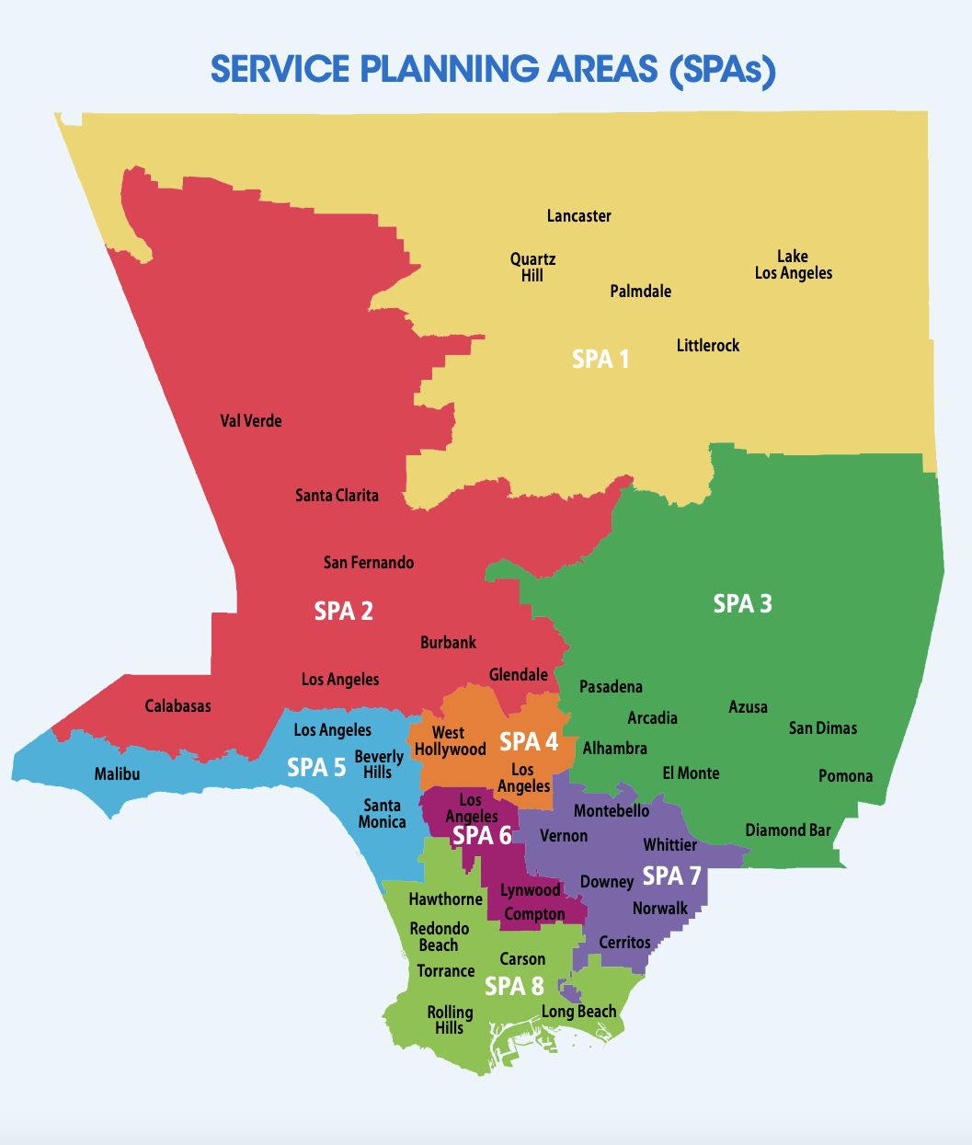
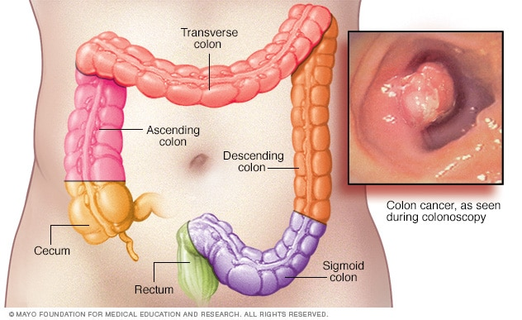

Intro
Colorectal Cancer and Colon Anatomy
From Mayo Foundation for Medical Education
From Key Indicators of Health by Los Angeles County Department of Public Health, 2017. (p. 4)

Slide 3
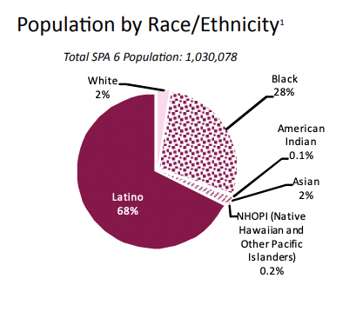
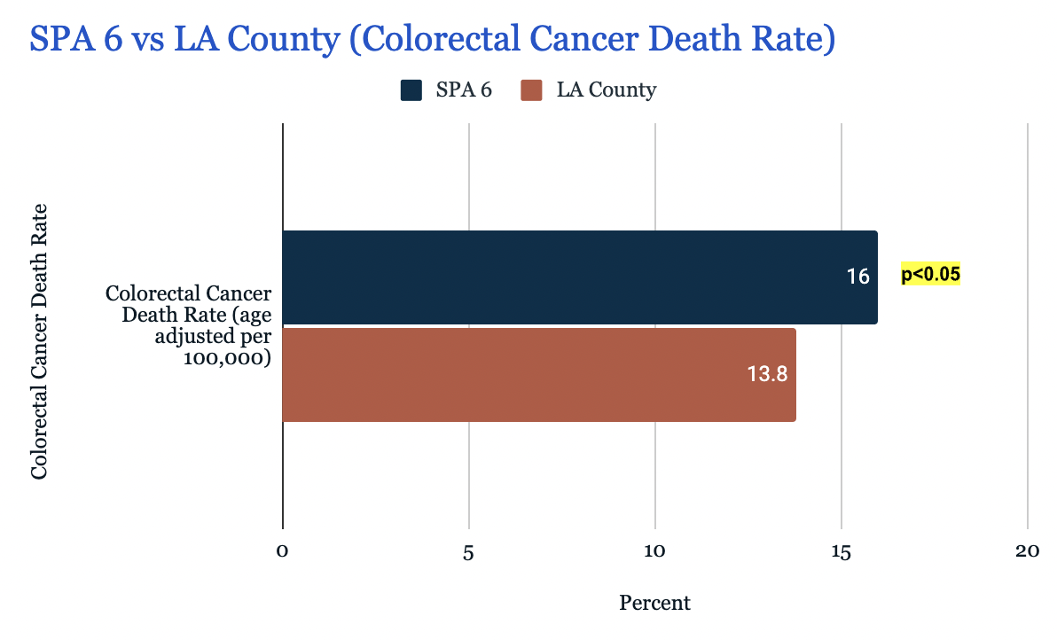
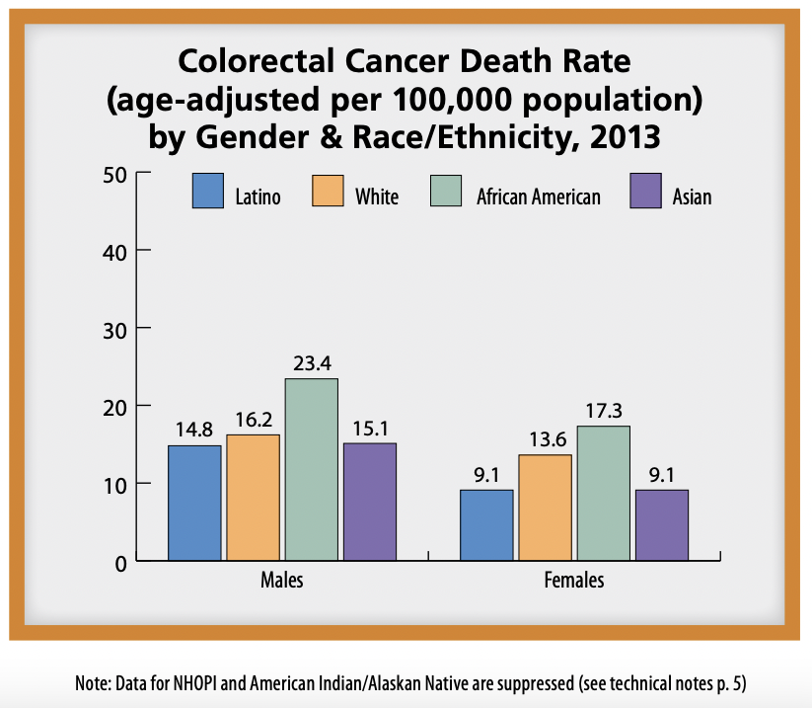
Intro (cont.)
From Supplement to Health Assessment Report: SPA 6 (p. 1)
From Key Indicators of Health by Los Angeles County Department of Public Health, 2017. (p. 24)

Slide 4


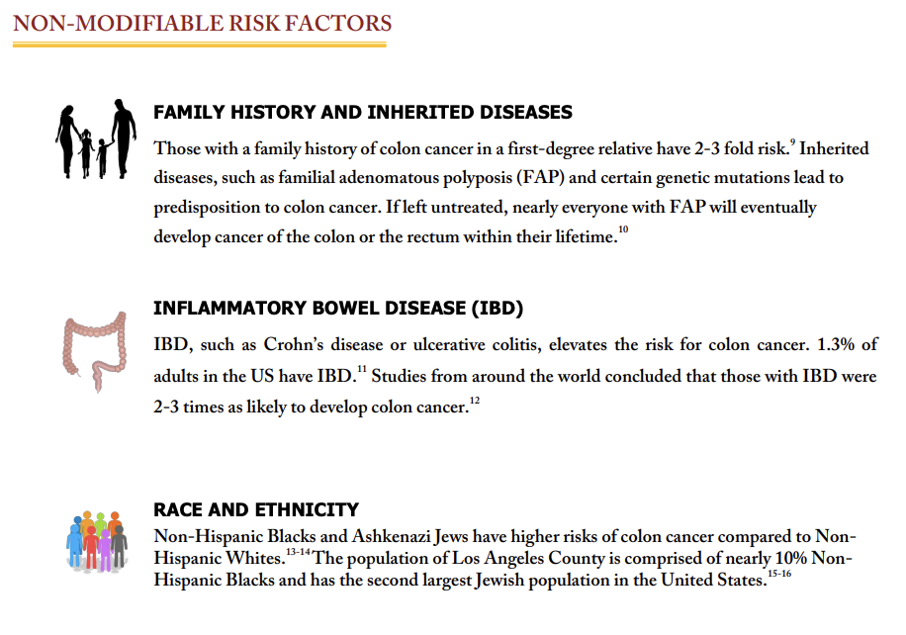

Literature Review
Quick Notes
High BMI (Johnson et al., 2013)
Low Exercise (Johnson et al., 2013)
Housing Instability (Asgary et al., 2014)
Smoking (Johnson et al., 2013)
Family History (Johnson et al., 2013)
Low SES (Doubeni et al., 2013)
Low Fruit/Veggie
(Johnson et al., 2013)
Low CRC Screening
(Maciosek et al., 2006)
Alcohol (Rogers et al., 2019)
High Red Meat (Johnson et al., 2013)
High Sugar Sweetened
Drink (Hur et al., 2020)
IBD (Johnson et al., 2013)

Slide 5

Methodology
- Inclusion: adults (age> 18) who reside in LA County or specifically in SPA 6
Risk Factors
Biological
Socioeconomic
Behavioral
(Health Behaviors + BMI)
Step 1
CRC Risk factors examined and classified into groups
Step 2
Step 3
Supplement to Health Assessment Report: SPA 6 for extra data; charts were created to compare data
Cross sectional research study using secondary data from Key Indicators of Health Report (2017) to gather data

Slide 6
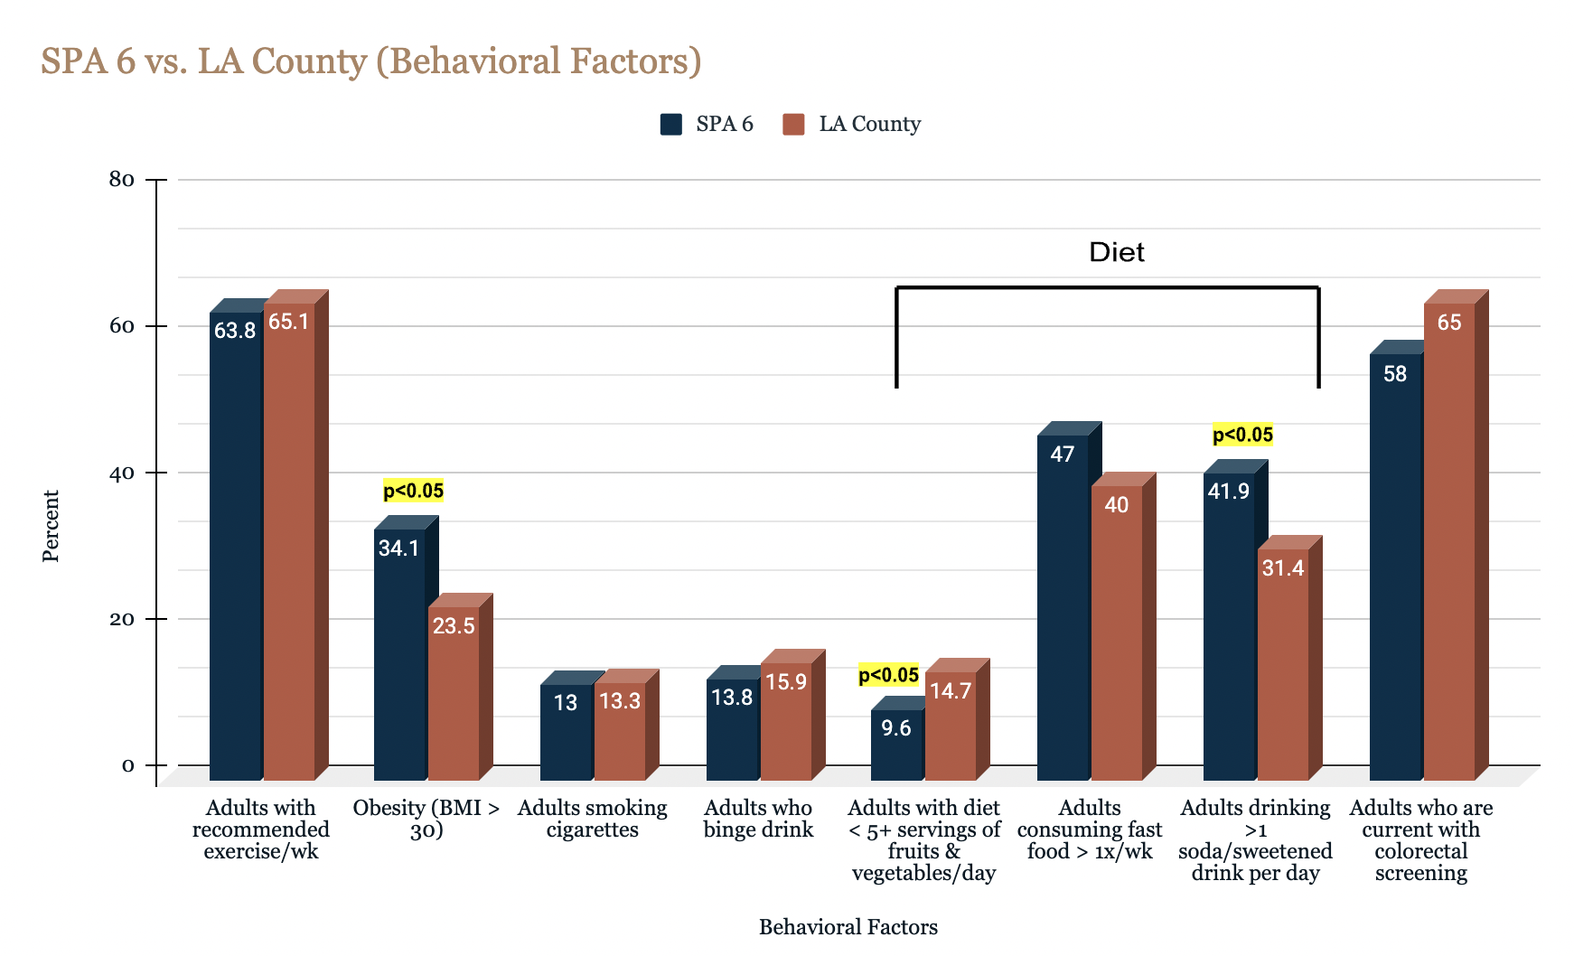
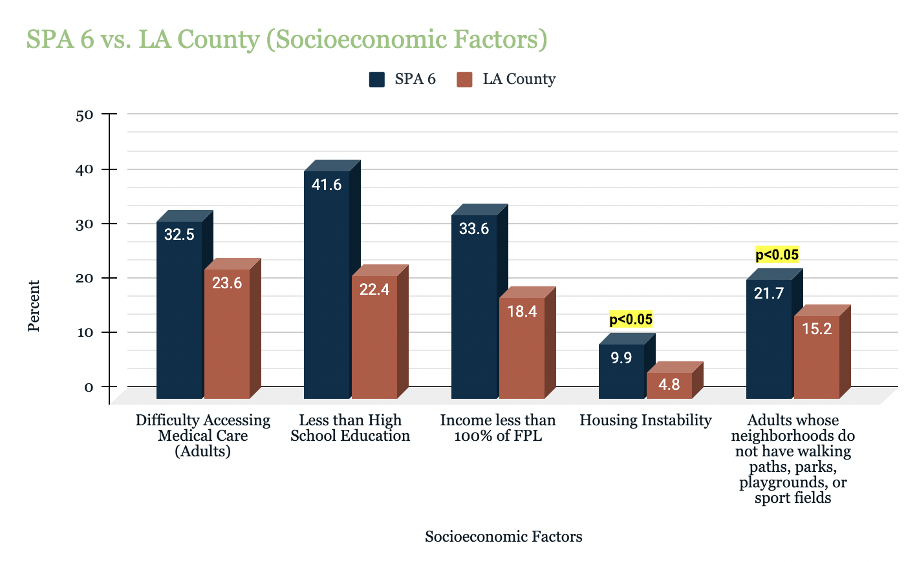
Results
Significant Results
Behavioral
  Obesity
  Alcohol
  Low Fruit/Vegetable Consumption
Socioeconomic
  Housing Instability
  Less access to facilities for physical activity
Unable to find biological CRC risk factor data on SPA 6 or LA County
IBD
Familial History of CRC

Slide 7

Discussion
& Conclusion
Limitations
Biological Factors- no data for SPA 6 and LA County
Time Constraint
Significant Socioeconomic Factors (p<0.05)
Housing Instability
Neighborhoods without walking paths, parks, playgrounds, or sports fields
Significant Behavioral Factors (p<0.05)
Poor diet with p<0.05 for 2 of 3 factors (increased soda/sweetened beverage consumption and low vegetable/fruit consumption)
All risk factors greater in SPA 6 than LA County Overall
Except smoking and alcohol consumption
Future Direction
Data on biological factors
Important to look at how socioeconomic and behavioral factors are connected
urban area + SES → no access to healthier foods
Decreased Access to healthcare → decreased CRC screening rates
Less facilities for exercise → less exercise levels

Slide 8

References
&
Acknowledgements
- Juanita Booker-Vaughns, Ed.D.
- Project STRIDE Program at Charles R. Drew University of Medicine and Science
- Doris Duke Charitable Foundation

